Slide 1
The 3rd Conference on Information Technology and Data Science
Connecting to an online session via application
University of Debrecen, Faculty of Informatics August 26—27, 2024

Slide 2
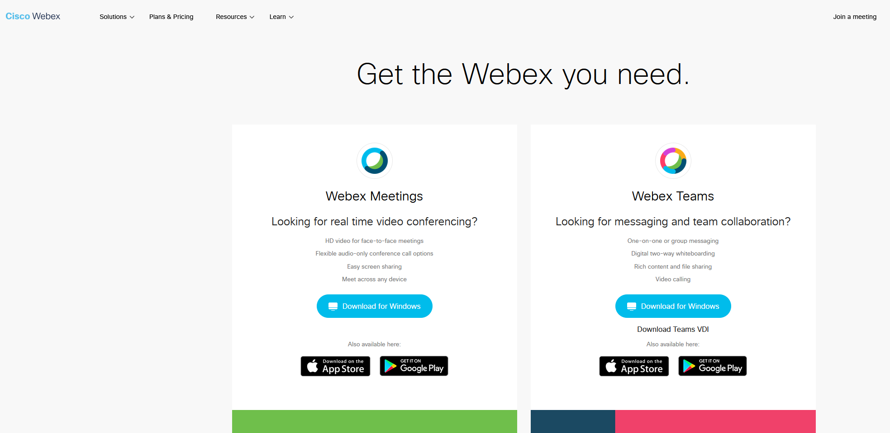
To download the application, please click on the following LINK, then click on the Download button and install the application!

Slide 3
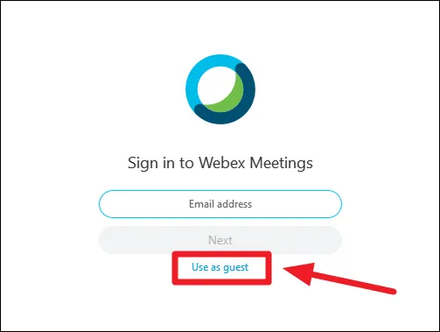
In the following window click on Use as guest and then please enter your full name and the email address, that you used for the registration

Slide 4
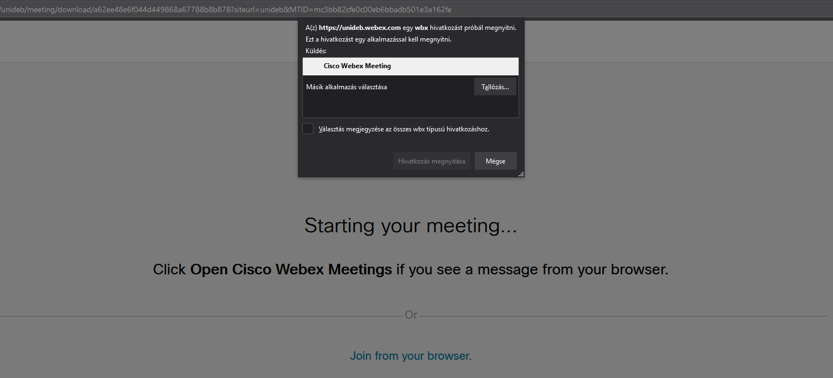
Now if You click on a session on the program page, you will be directed to the following window:
Here please click on Cisco Webex Meeting and then open the link.

Slide 5
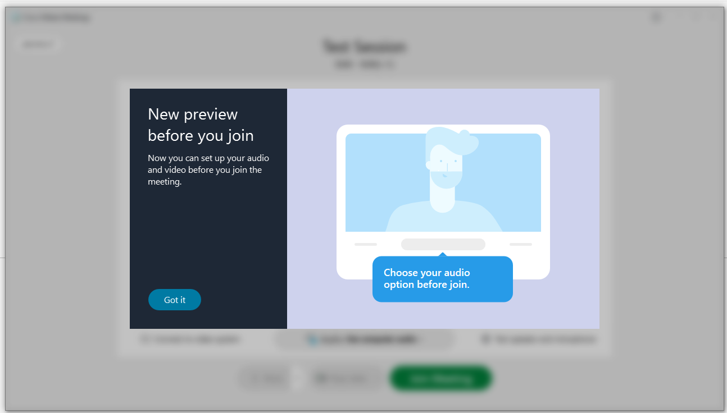
Here click Got it

Slide 6
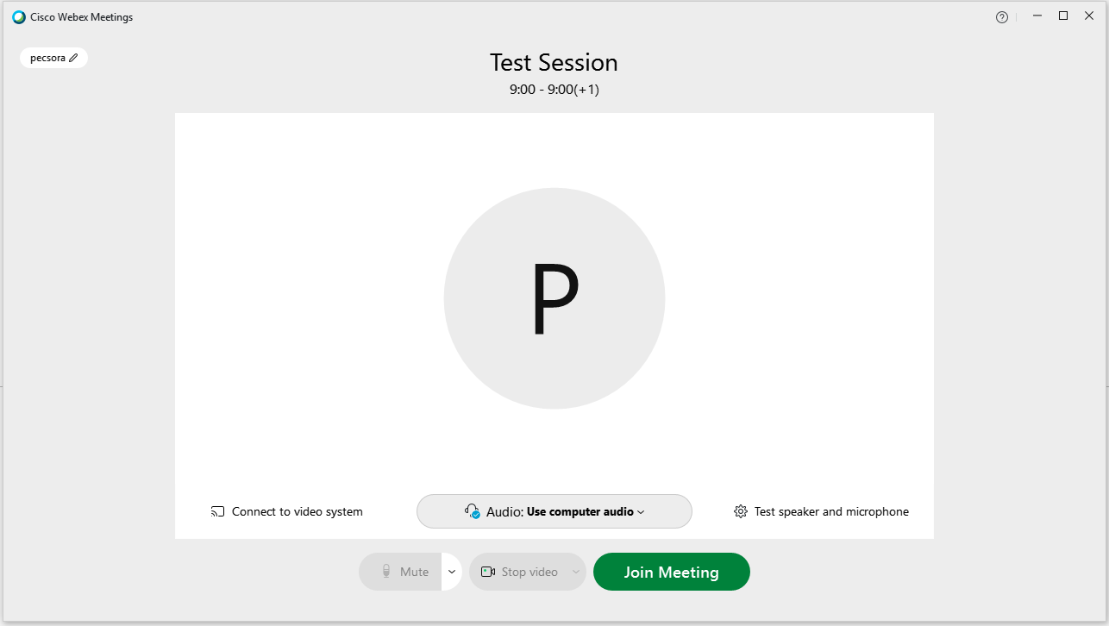
Here click Join Meeting

