Slide 1
The 3rd Conference on Information Technology and Data Science
Connecting to an online section
University of Debrecen, Faculty of Informatics August 26—27, 2024

Slide 2
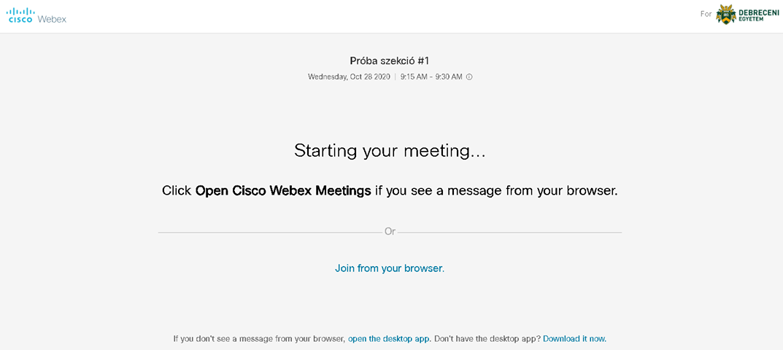
After clicking on the Join link on the conference’s webpage, the following page will appear:
If you click on the Join from your browser. link, you can join the section from your internet browser (preferably Firefox or Chrome) without any additional software.

Slide 3
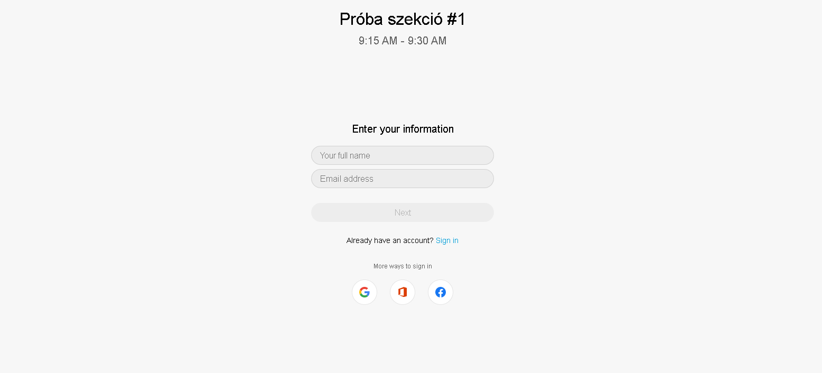
On the following page, please enter your full name and the email address, that you used for the registration

Slide 4
On this page, you are asked to allow the browser to use your microphone and webcam, if you are a presenter in this section, you have to allow it.
Then you can click the Join meeting button, to participate in the section.

Slide 5
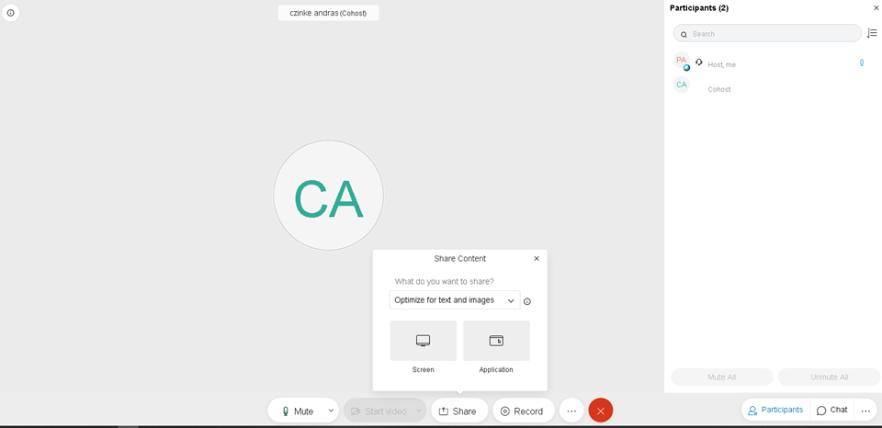
When it is your time to present in the section, please click on the Share button, then click on the Applications button and choose the application you want to share with the audience (for example: Adobe Acrobat Reader or MS PowerPoint)
If you would like to use the chat, please click on the Chat button.

Slide 6
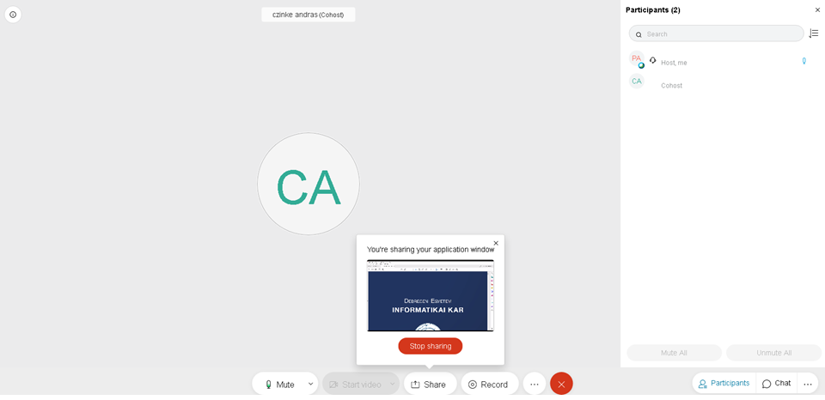
At the end of the presentation, you can stop sharing by clicking Share then Stop Sharing

